Slide 1

Ostazi Del Escola
Italian restaurant

Slide 2
New business
Road map
Stages to complete
First stage is crucial
Location

Slide 3
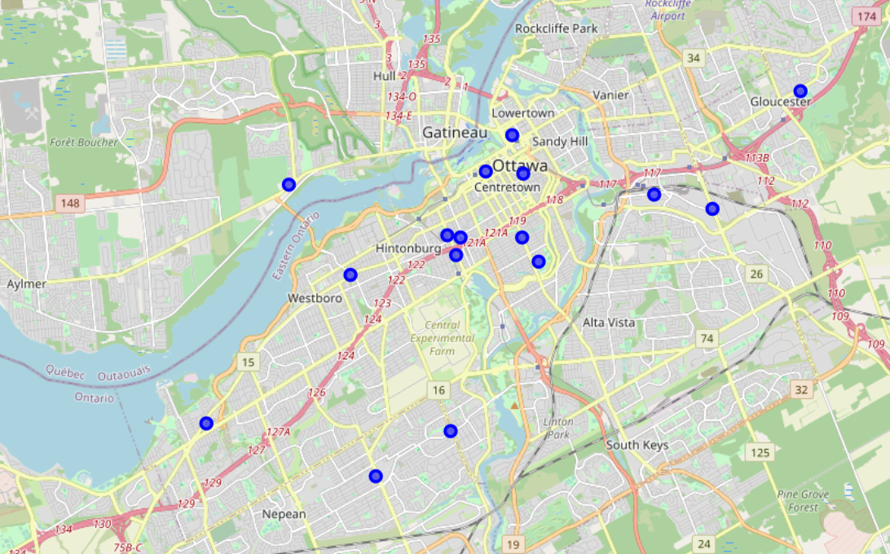
Criterium
New restaurant
Italian cuisine
Other restaurants’ locations
Draw footsteps

Slide 4
Location
East?!
South?!

Slide 5
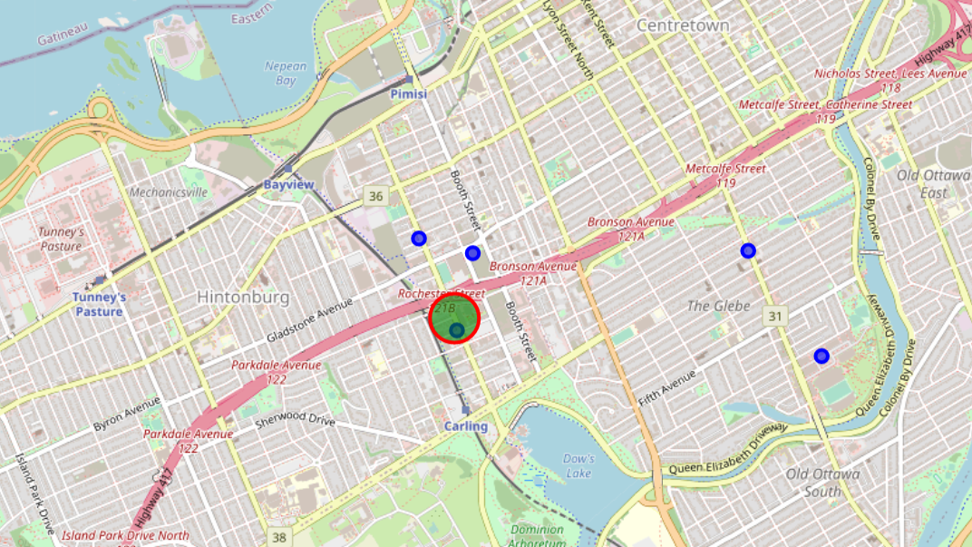
Little Italy
As an important step, first customers are better to be familiar with the cuisine to get crucial feedbacks about the restaurant operation.

Slide 6
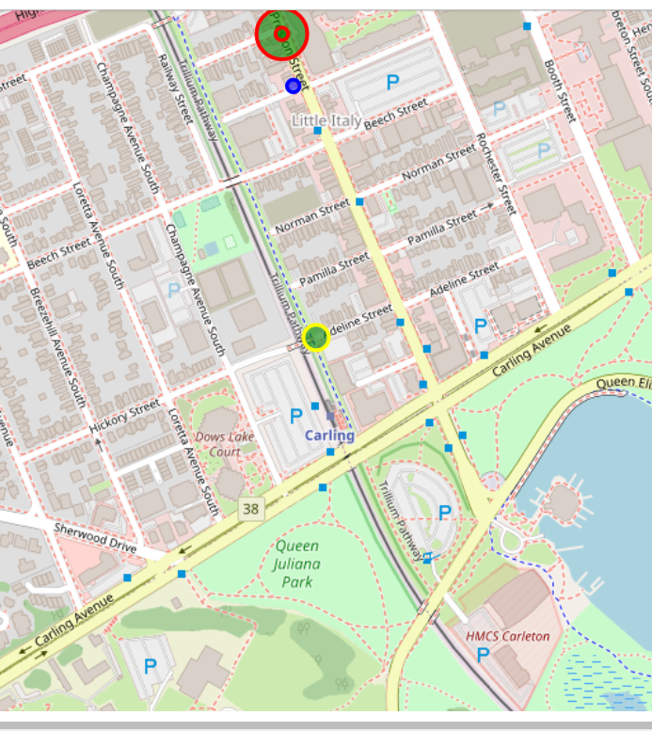
Access
Major venues
O-train
Bus
Car

